Slide 1
Powering the Solar Car
William Shih, Deputy Race Director

Slide 2
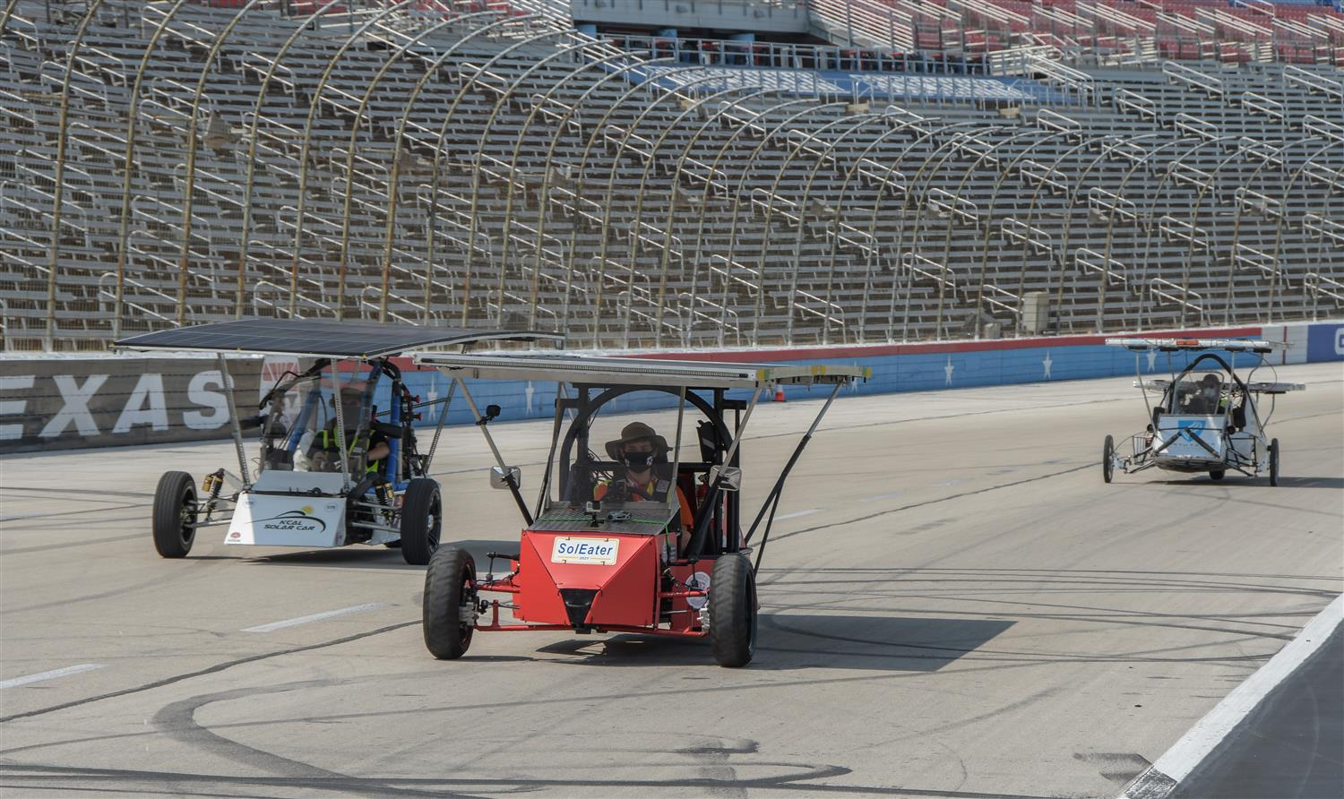
Powering the solar car
How do you get the car moving?
  Photovoltaic array choices
  Power trackers
  Electric motors and controllers

Slide 3
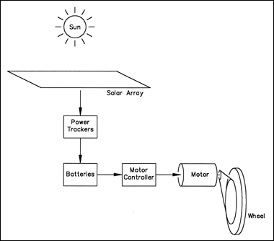
Powering the solar car
Solar Arrays
Maximum Point Power Trackers (MPPT)
Batteries
Electric Motors
Gearing
The Electrical System
Everything Else Electrical

Slide 4
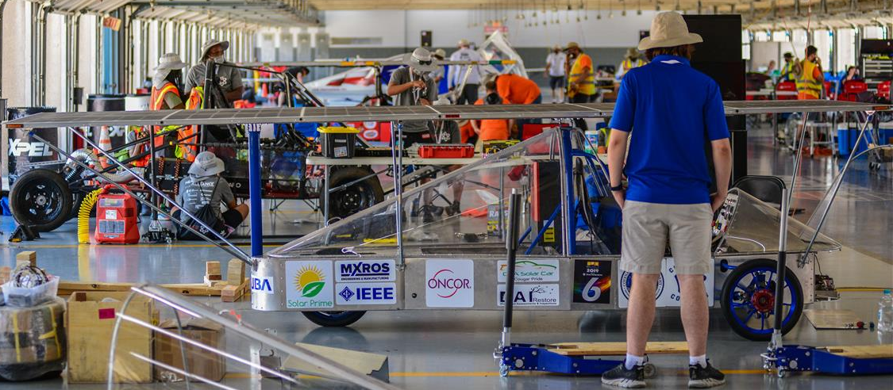
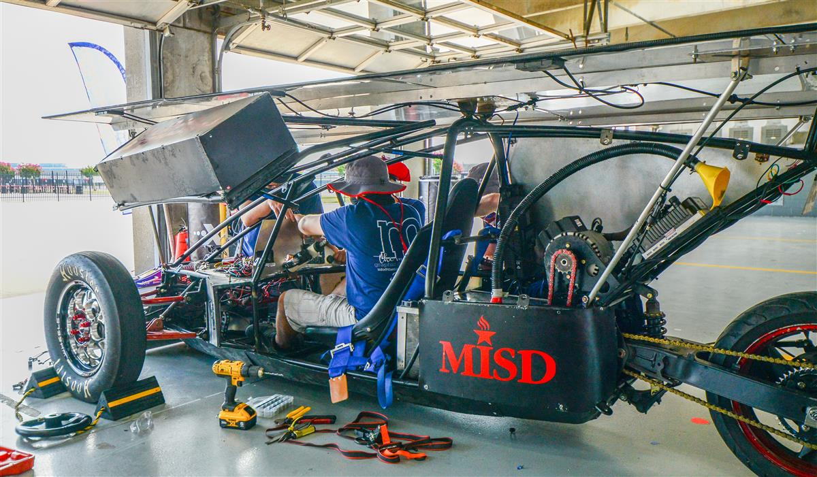
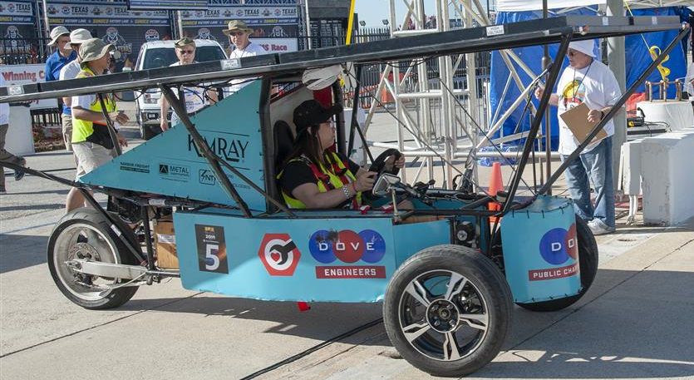
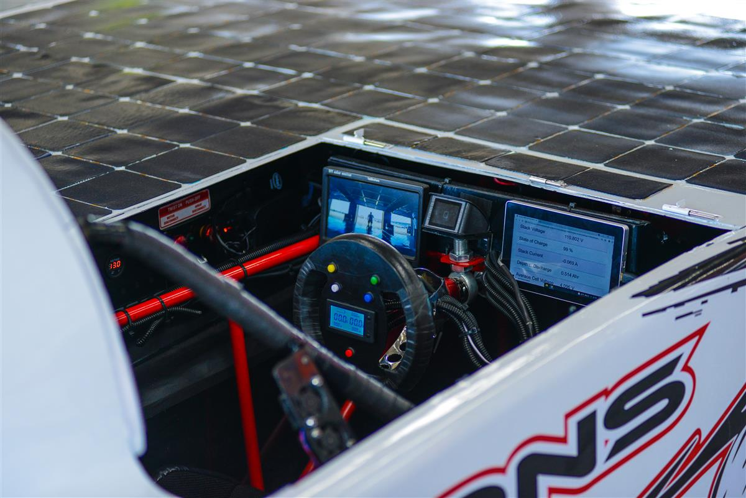
Substrate and Support Frame
Varies Depending on the Type of Array
Main Considerations
  Rigidity
  Cooling
  Weight
  Conductivity

Slide 5
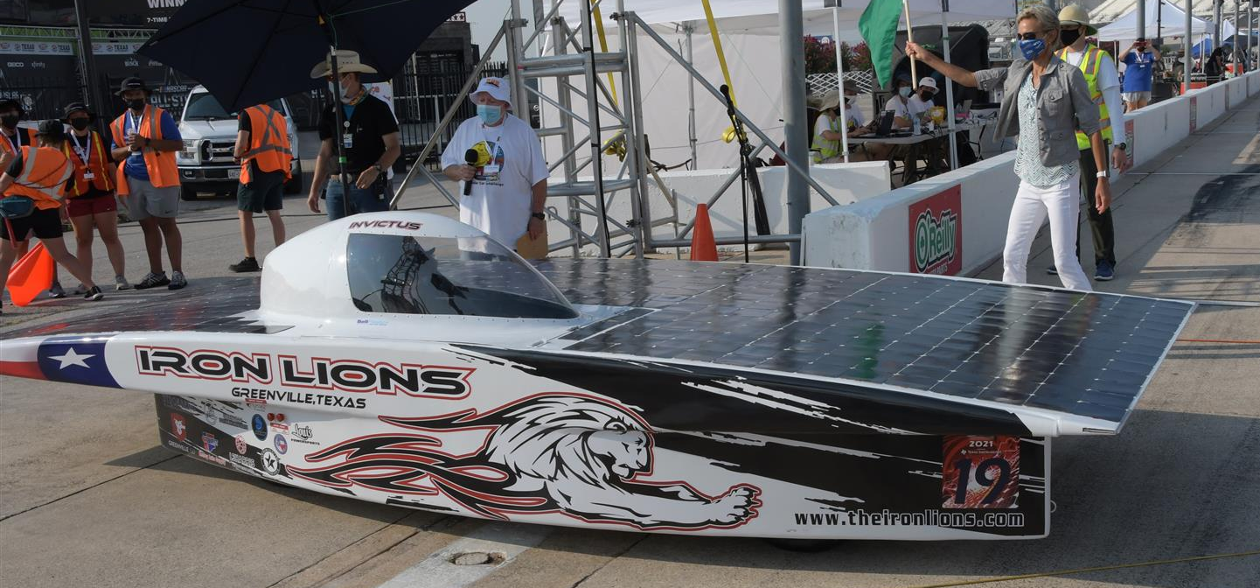
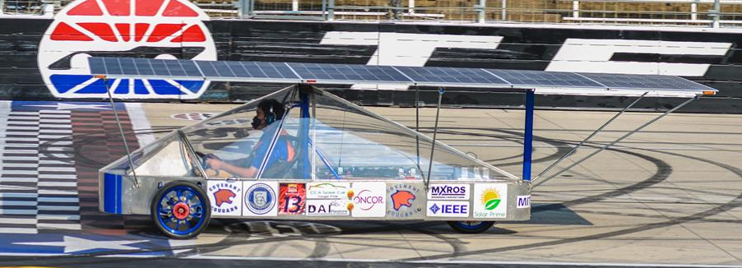
Shape of Array
Flat Solar Arrays
  Easier to execute
  Angle to sun less of a concern
  Wing over body vs Canopy Above Array

Slide 6
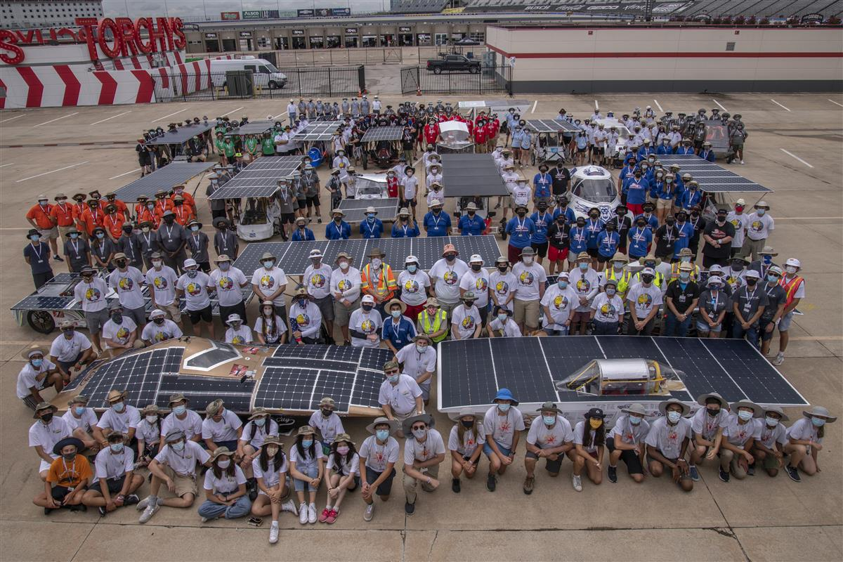
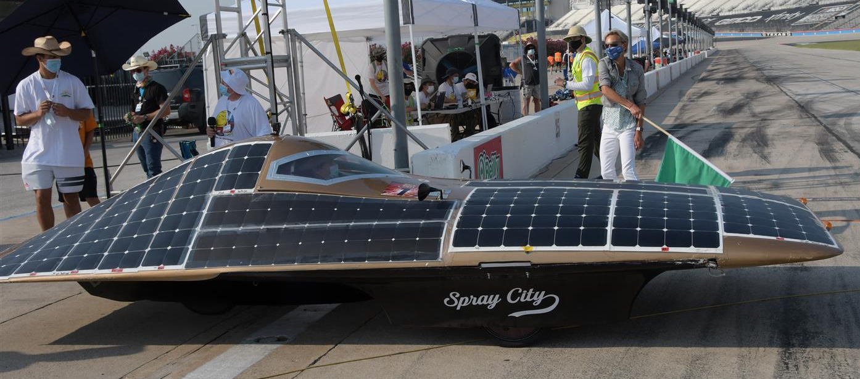
Shape of Array
Curved Solar Arrays
  Higher the angle the greater chance for breaks without ideal support.
  Angle to sun more of a concern

Slide 7
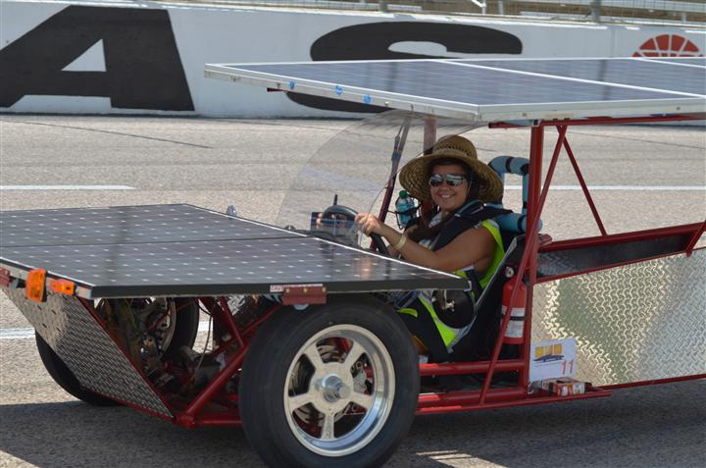
The Solar Array
Pre-made Commercial panels
  Reliable
  More Easily purchased
  Typically HEAVY (glass top adds weight)

Slide 8
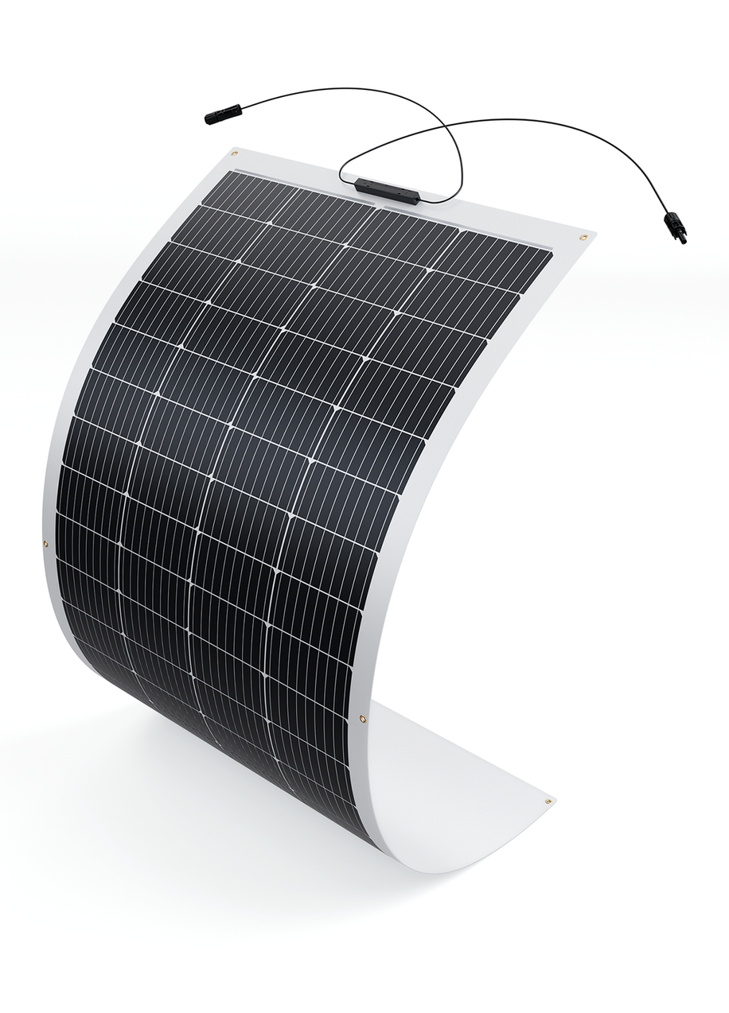
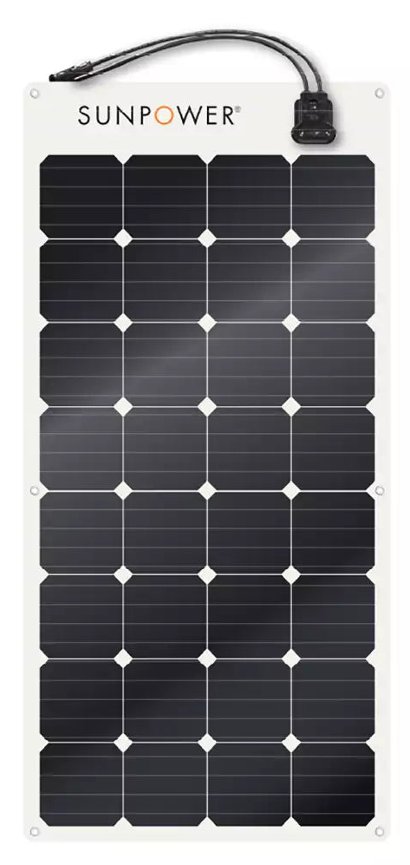
The Solar Array
Pre-made Semi-Flexible panels
  Lightweight
  (but requires own framing)
  Typically less efficient
  (junction boxes)
  Readily available

Slide 9
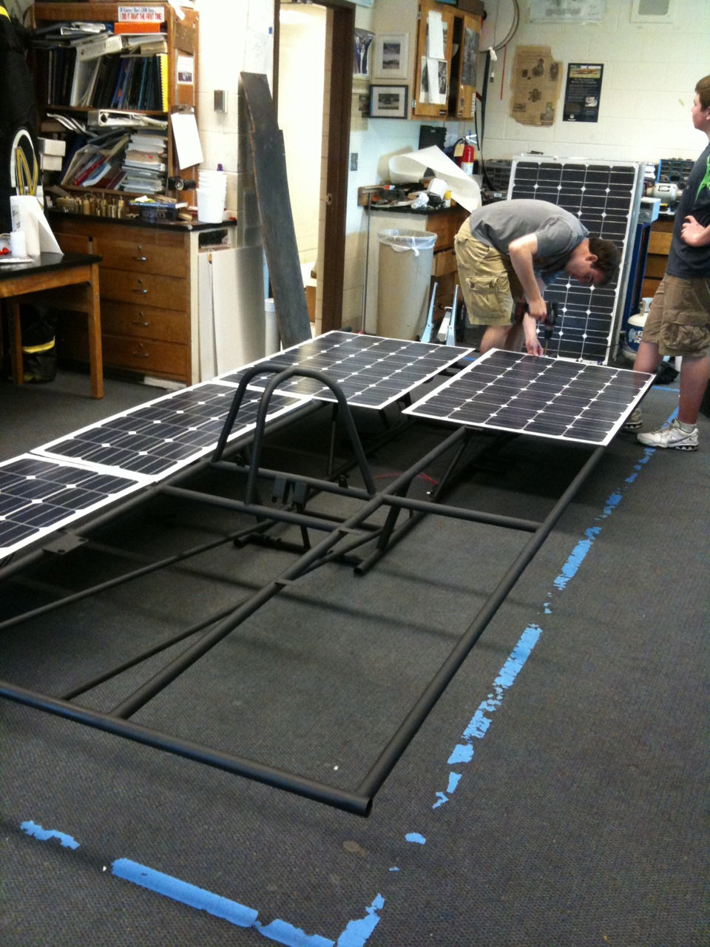


The Solar Array
Pre-made or Custom panels
Many more on our website and online…

Slide 10

The Solar Array
Raw cells and lamination
  Planning has to start FAR in advance (you are probably too late already!)
  Process is expensive
  Panels are very light and can be built to fit your car
  Easy to maximize power and reduce aerodynamic drag
SunCat Solar – encapsulation services

Slide 11
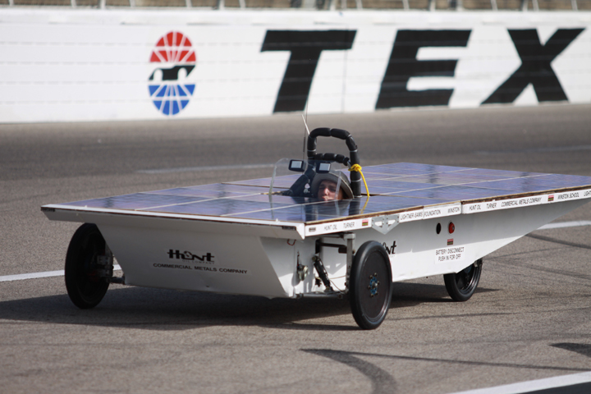
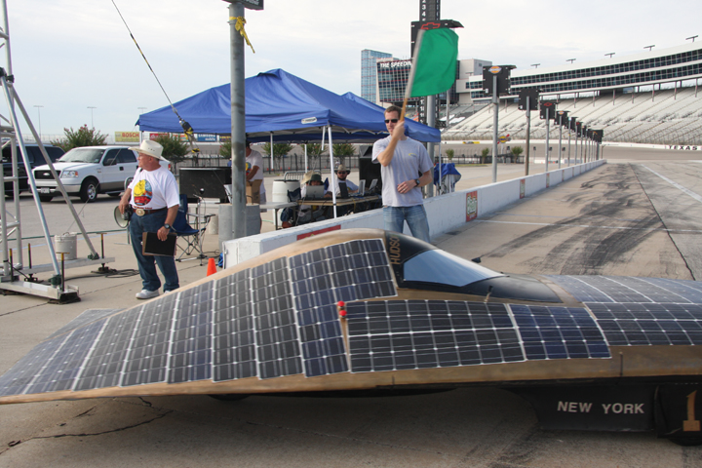
Laminated Cells

Slide 12
The Solar Array
Do-it-yourself solar array
  Amazing learning experience
  Learning curve is steep
  Hard to find raw cells
  Takes a lot of man power
  Hard to watch when cells are continually breaking
  Can fit exactly to your car

Slide 13
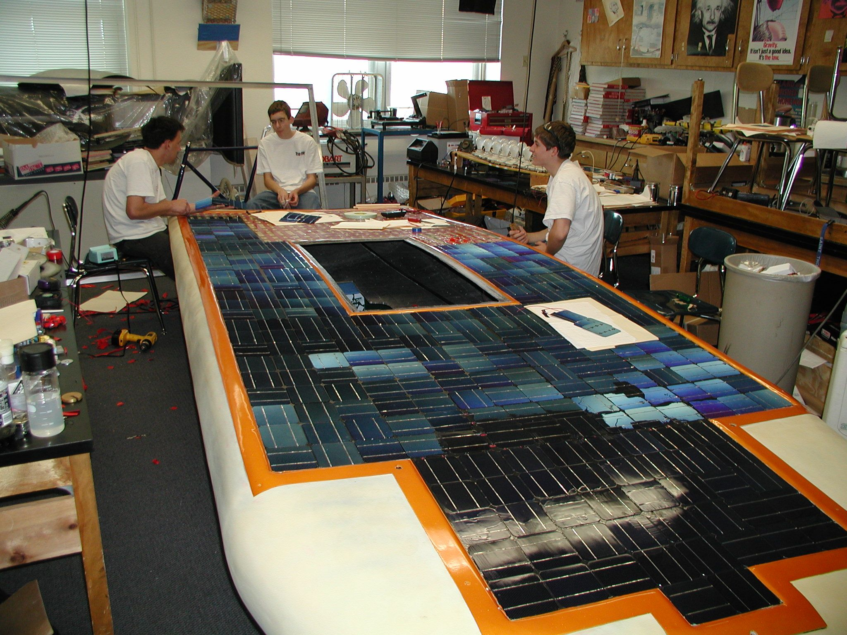
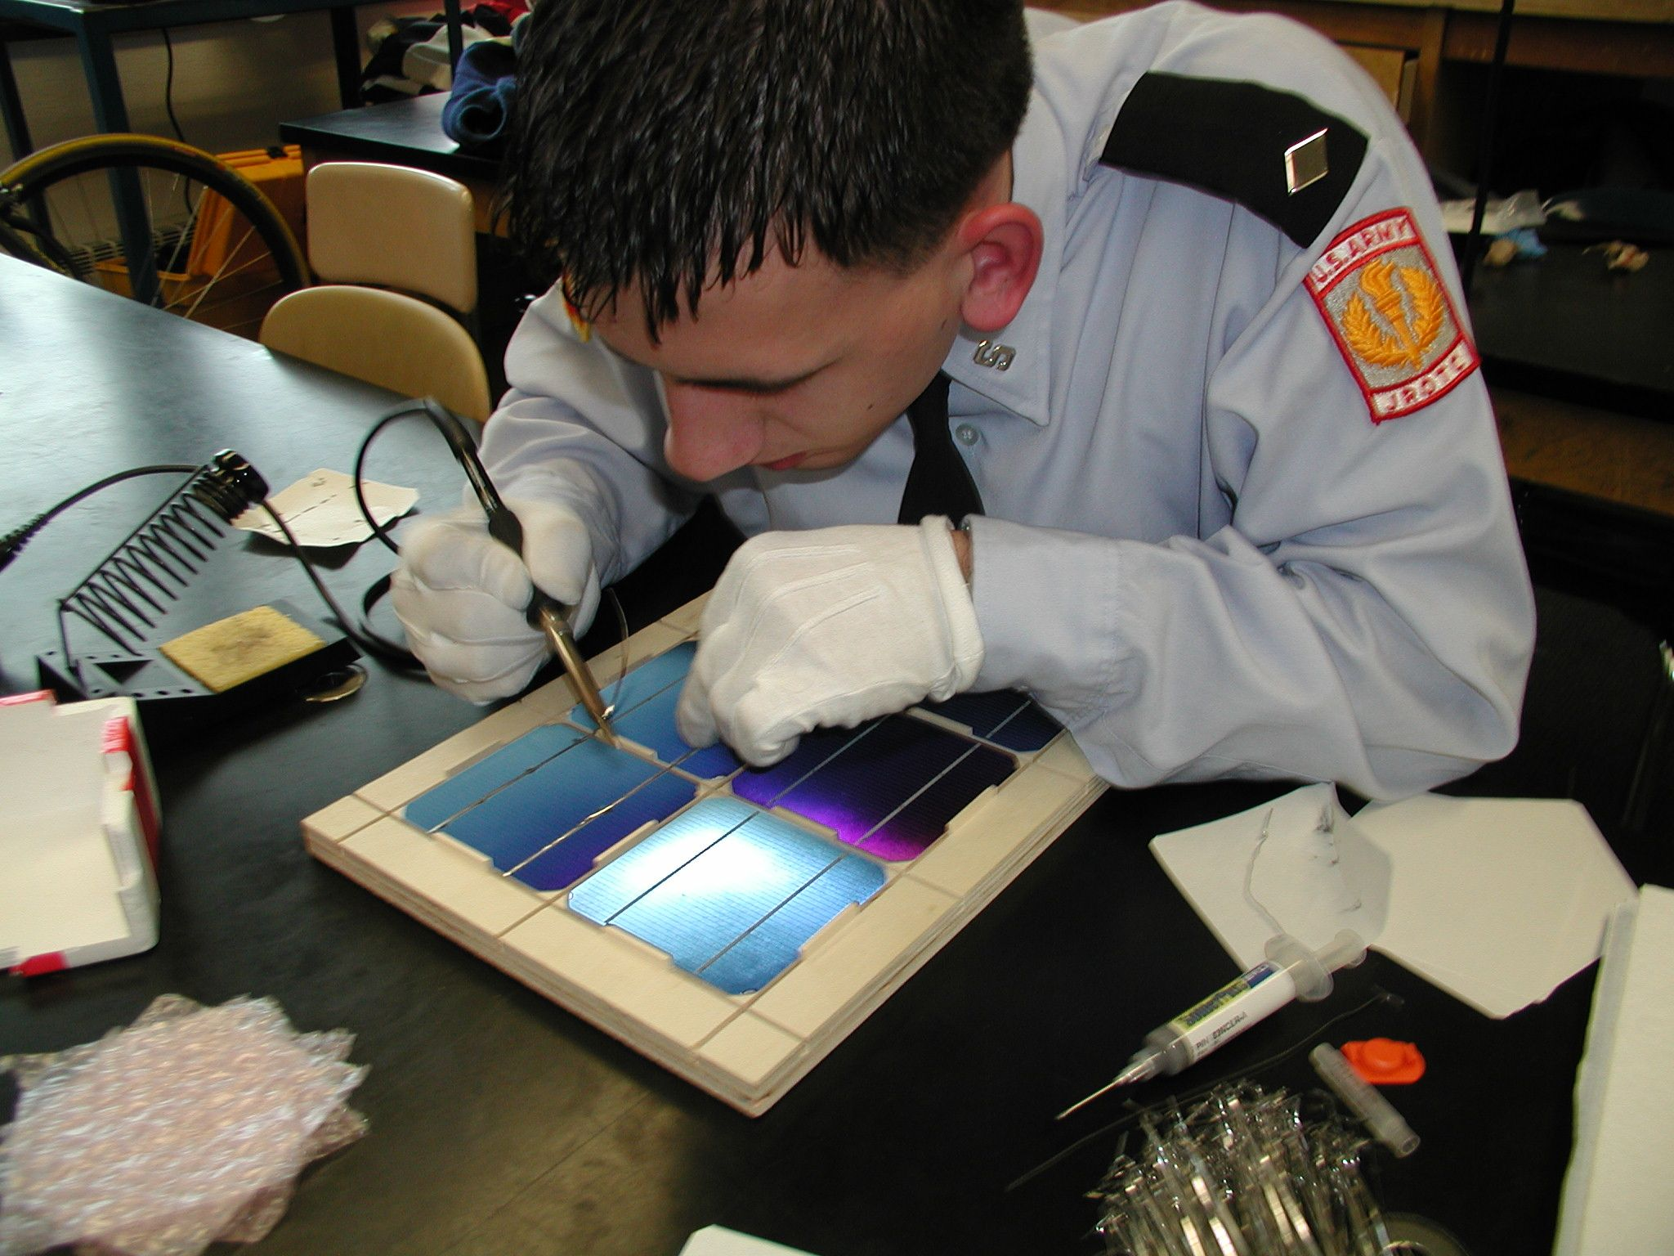
Do-it-yourself

Slide 14
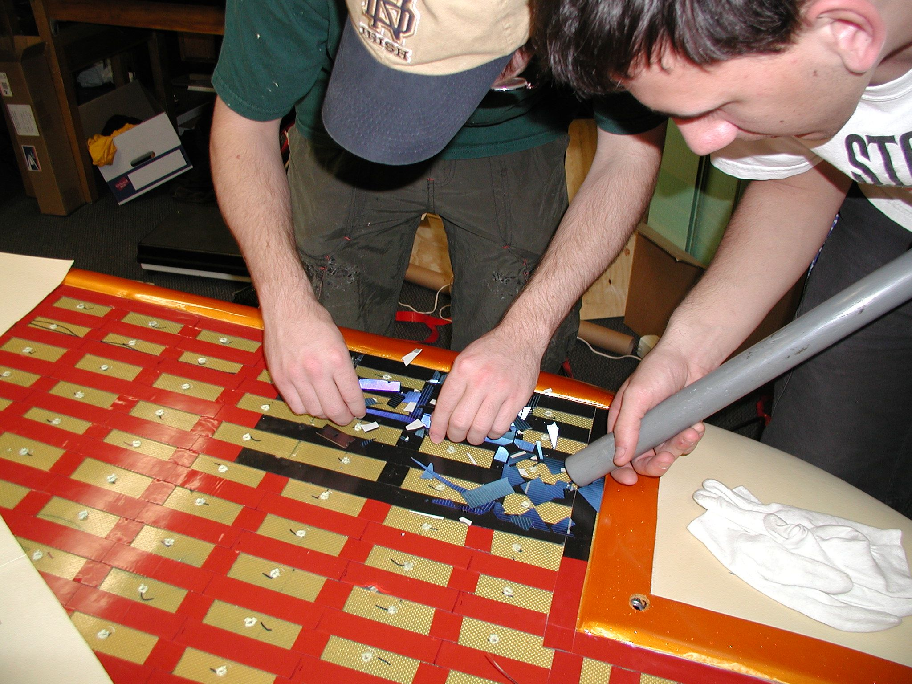
Do-it-yourself

Slide 15
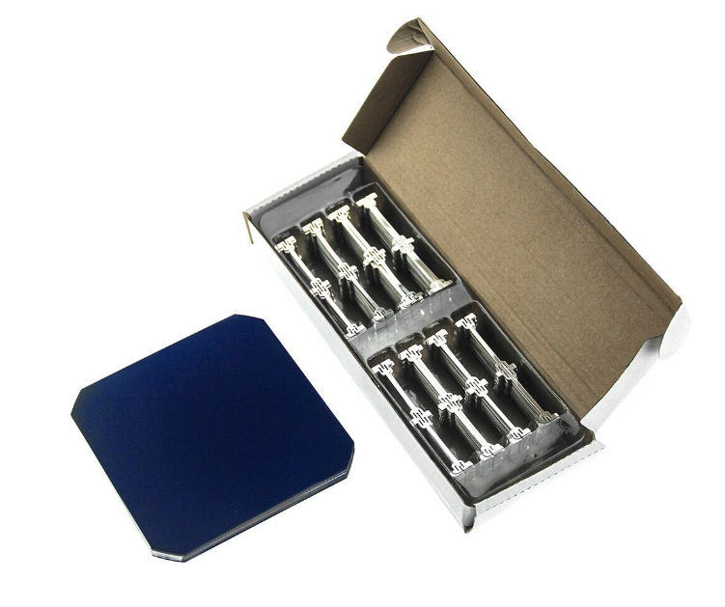
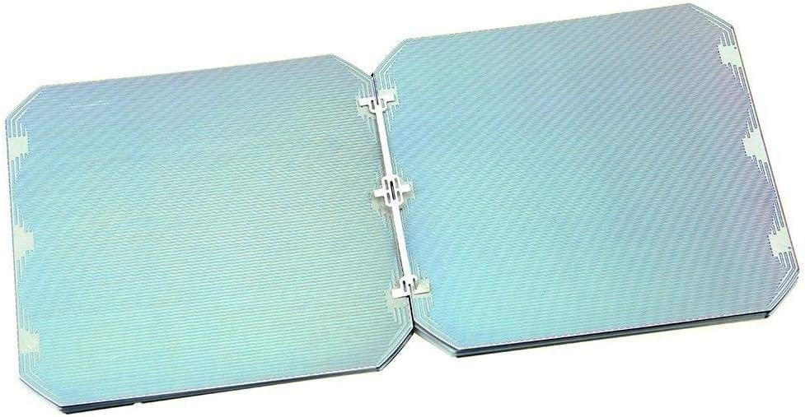
SunPower Wishbone Tabs
Tabbing makes it easier to solder
Cells are still fragile

Slide 16
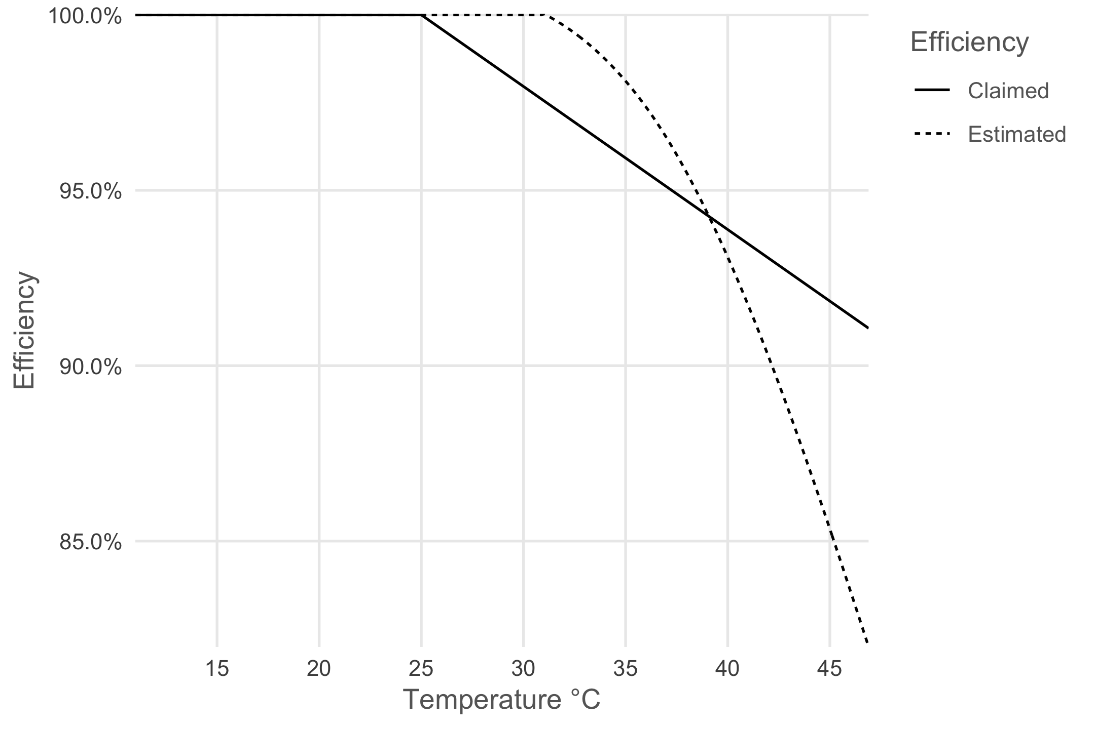
Panel Temperature
Solar Cells change efficiency as their temperature changes
https://www.jeroenboeye.com/blog/solar-panel-analysis-pt-2-temperature-and-efficiency/

Slide 17
Powering the solar car
Solar Arrays
Maximum Point Power Trackers (MPPT)
Batteries
Electric Motors
Gearing
The Electrical System
Everything Else Electrical

Slide 18
Maximum Point Power Trackers (MPPTs)
Moving power from the solar array to the batteries is not as easy as hooking up a couple of wires!
  Voltage from your solar array needs to match the voltage of the battery pack.
  More often than not the group of solar panels will not match your system / pack voltage
  Even if you do match the pack voltage it will not be efficient for charging your battery pack
  Without protection you can have reverse current flow into the panels when they are shaded

Slide 19
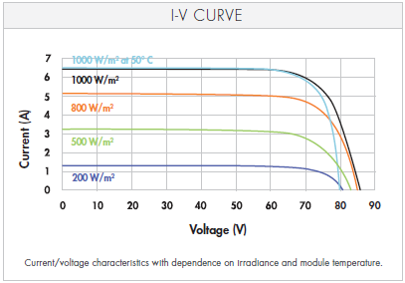
What MPPTs Do
Maximum Power Point Trackers (MPPTs) adjust voltage and current from your array to give you the most efficient transfer of power to your vehicle
  They adjust the output voltage of your array to always be at the right voltage for ideal charging of your battery
  They can either “boost” voltage (40V to 72V) to a higher value or “buck” voltage (140V to 80V) to a lower value
MPPTs are also a main source of telemetry for your array

Slide 20
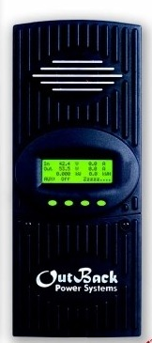
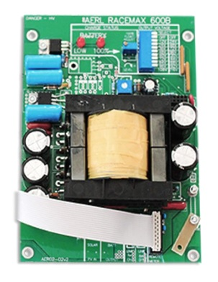
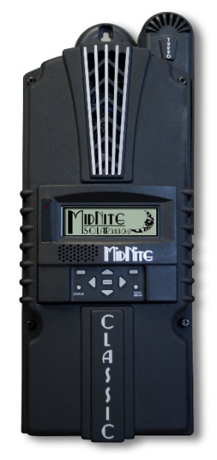
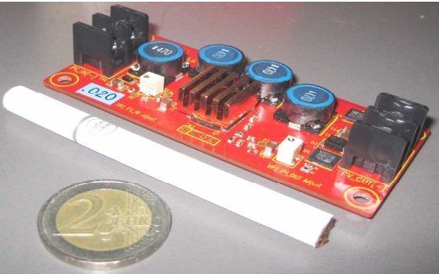
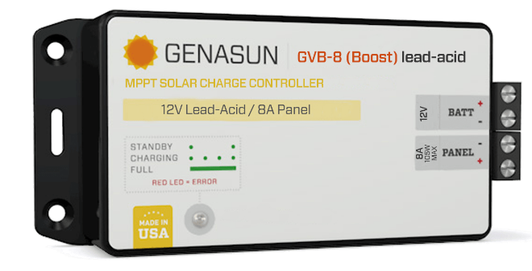
MPPT Choices
AERL (Australian Energy Research Laboratories) RaceMax 600B
  Needed for V_{out} > 72V
Nomura MPPT
  Small/light, V_{out} = 34.5V
MidNight Solar / Outback Power (and other grid type MPPTs)
Genasun
DC-DC Converters → Don’t do this!
https://www.facebook.com/NomuraCo/photos/a.2709579579286363/2709579905952997/

Slide 21
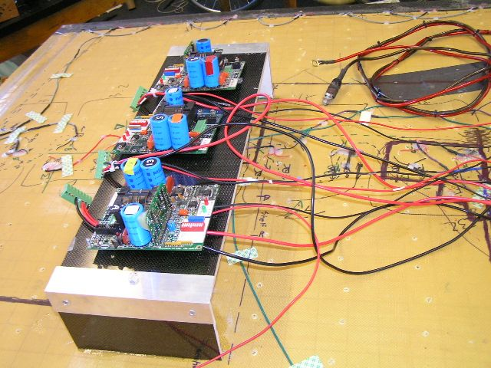
AERL MPPTs

Slide 22
Powering the solar car
Solar Arrays
Maximum Point Power Trackers (MPPT)
Batteries
Electric Motors
Gearing
The Electrical System
Everything Else Electrical

Slide 23
Batteries
Choose carefully!
Batteries are one of the areas where you get what you pay for.
Decisions to make:
  What voltage does your car run at?
    Higher voltage means lower current
  How much weight can you carry?
  How much energy can you get at that weight?
  Can your solar panels recharge the battery pack?
  Is it a road race or a track race?

Slide 24
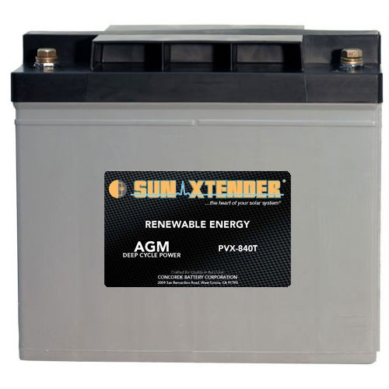
Batteries
The 5.25 kilowatt-hour rule
  kW-h = Amp-hours x Voltage
  (at the 20 hour discharge rate for PbAcid or 1C rate for LiFePO4)
Example:
  Four, 12 volt, 84 amp-hour batteries in series
  84ah x 48 v = 4032 watt-hours or 4.032 kilowatt-hours
  (this battery pack would weigh around 230 pounds)

Slide 25
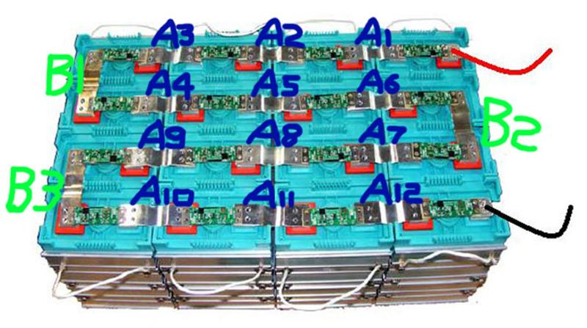
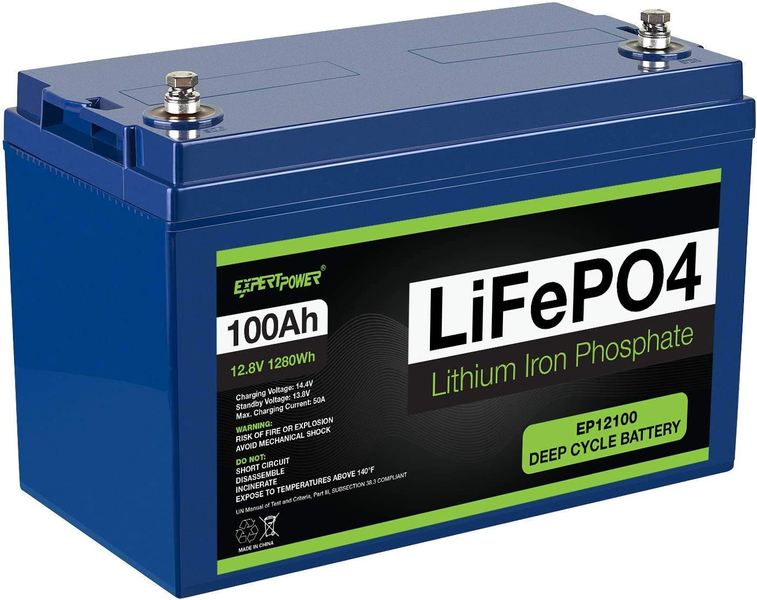
LiFePO4 Allowed!
Same power for less weight
  Lead Acid: 35-40 Wh/kg
  Lithium Iron Phosphate: 90-160 Wh/kg
Must have BMS monitoring batteries at a cell level
  Lithium cells are typically ~3V
  Monitor each series string (e.g. 4S2P = 4 taps)
  Need to verify manufacturer’s documentation for adequacy
Usually a drop-in replacement for lead-acid
Very stable chemistry (does not require Class D fire extinguisher)

Slide 26
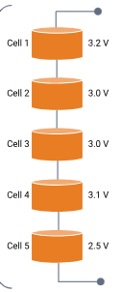
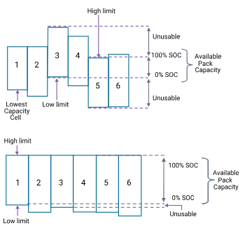
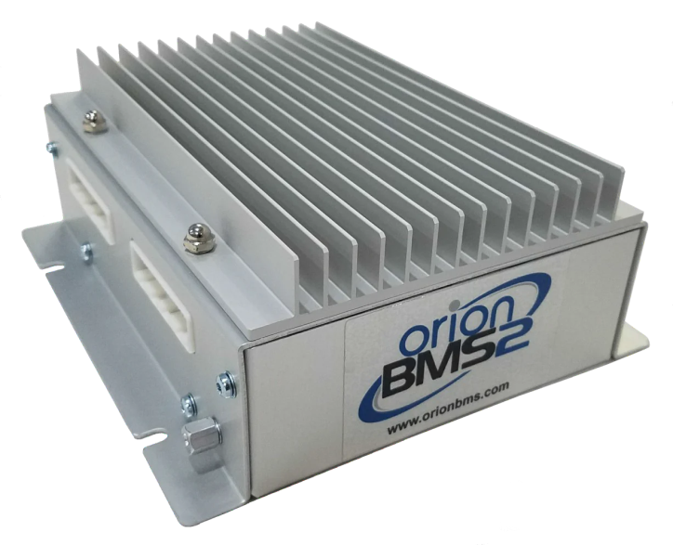
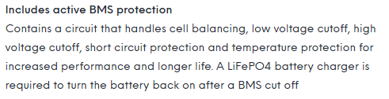
Battery Management Systems (BMS)
Protects against:
  Overvoltage/Undervoltage
  Overtemperature
Can also perform cell balancing
Need to consider integrated vs. separate BMS
  What protections are included?
  What parameters can you control?
  Additional features – auto-disconnect
Dakota Lithium Technical Specs

Slide 27
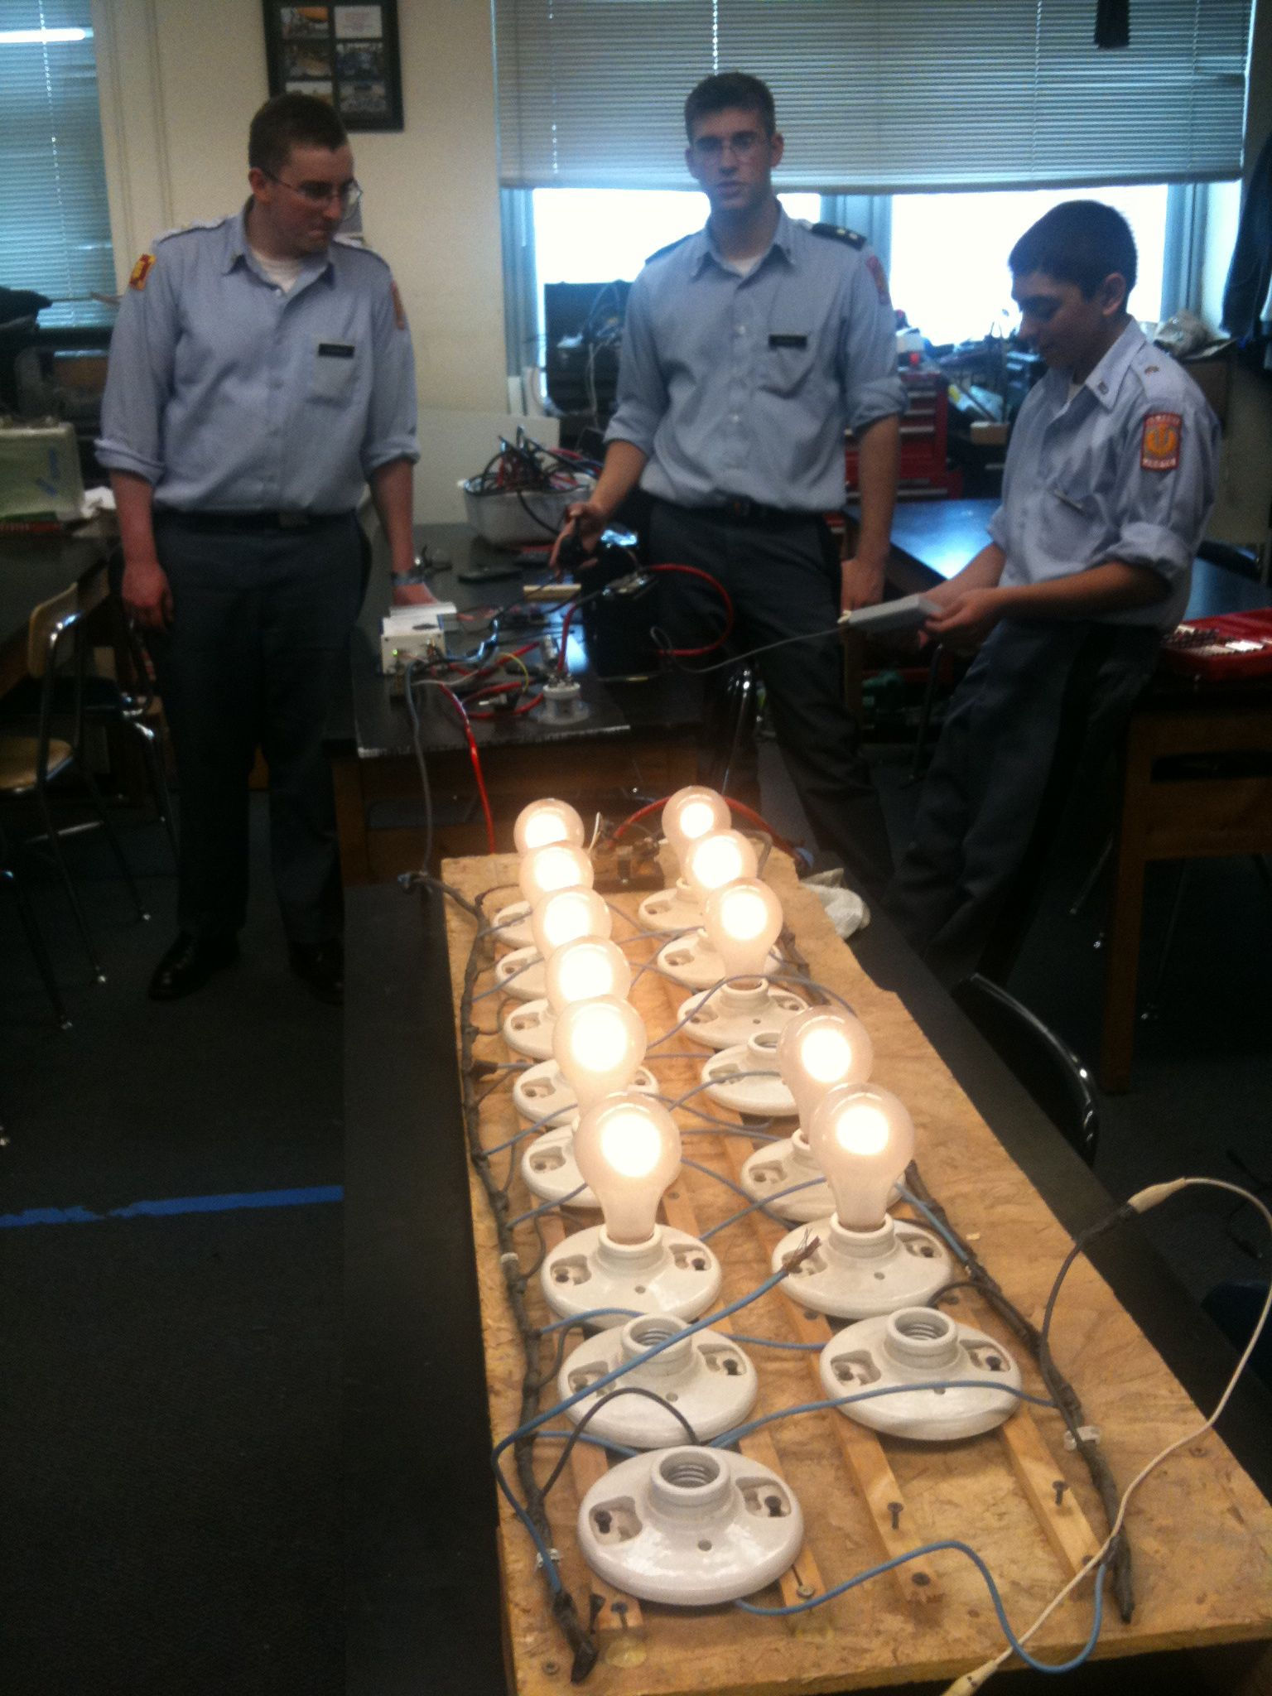
Testing Batteries
Understanding how your batteries perform is one of the most important things you can know BEFORE the race starts.
Carefully recording voltage, current, and amp-hours will help your team make good decisions during the race

Slide 28

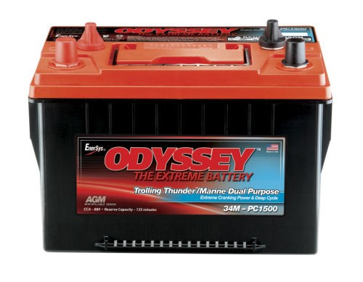
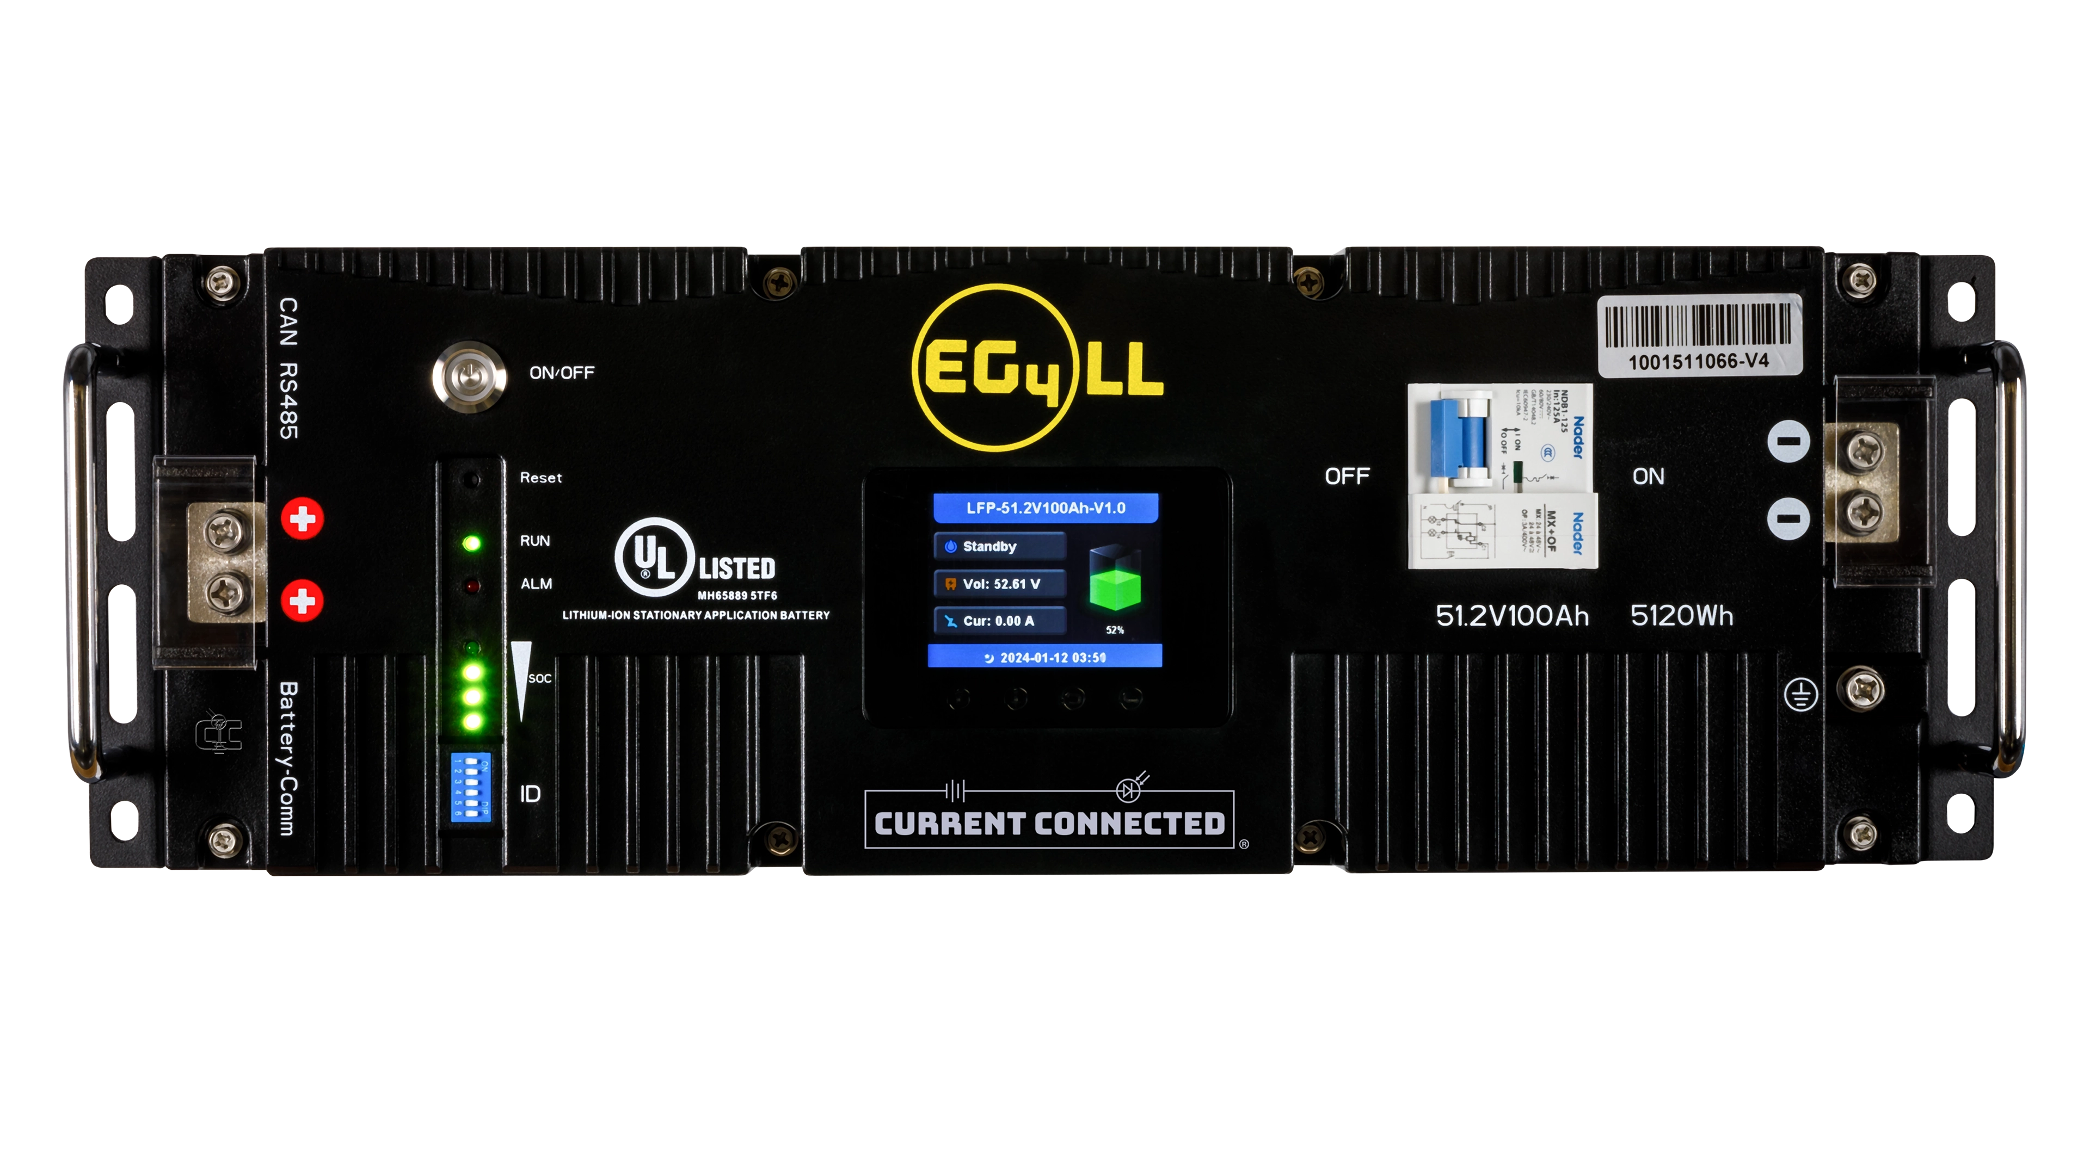
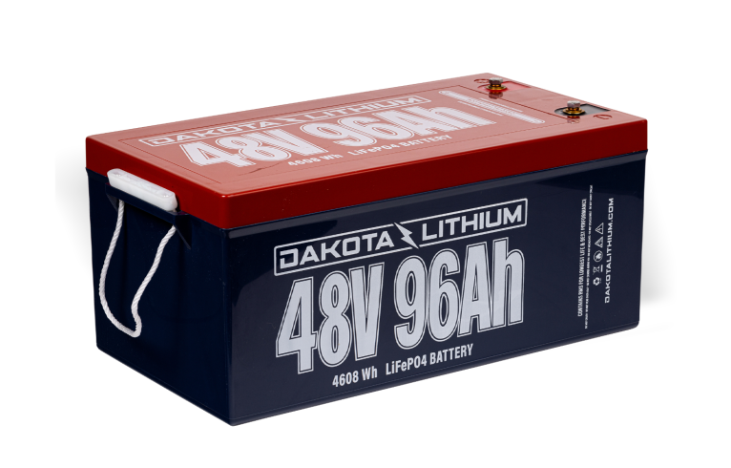
Some of the Team Favorites
Concorde Sun Xtender series
  12V 84 Ah $245/battery
EnerSys Odyssey Marine series
  12V 68 Ah $250/battery
EG4 Electronics LL-S 48V 100Ah
  51.2V @ 100Ah $1,299/battery
Dakota Lithium 48V 96Ah
  4608 Wh $2,699/battery

Slide 29
Powering the solar car
Solar Arrays
Maximum Point Power Trackers (MPPT)
Batteries
Electric Motors
Gearing
The Electrical System
Everything Else Electrical

Slide 30
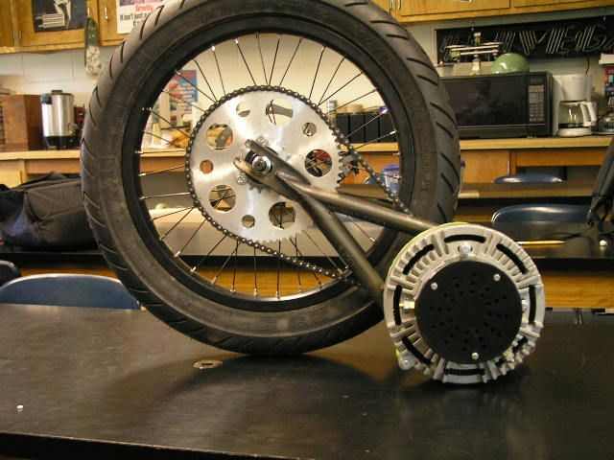
Electric Motors
Brushed Electric Motors
  Inexpensive
  Lower overall efficiency
  Controller is inexpensive and easy to wire
Brushless Electric Motors
  Very efficient
  More expensive
  Controller is more difficult to wire (typically 3 phase)

Slide 31
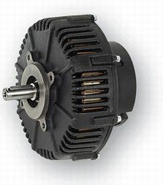
Brushed Motor Examples
Briggs and Stratton E-Tek
Lynch LM200
Perm-Motor PMG-132 12-72 VDC
(replacement for E-Tek)
  86% efficient @ 48 V, 88.6% @ 72 V
  Wide voltage range (24-72 volts)
  110 A (cont.), 200 A (peak)
  Lightweight (24 pounds)
  $1,025

Slide 32
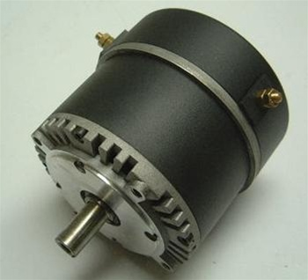
Brushed Motor Examples
Motenergy ME0909 Permanent Magnet DC
  Best replacement for original Briggs and Stratton E-tek
  12-48 volt
  4.8 kW (cont.), 15 kW (peak)
  Lightweight (24 pounds)
  Inexpensive ($500)

Slide 33
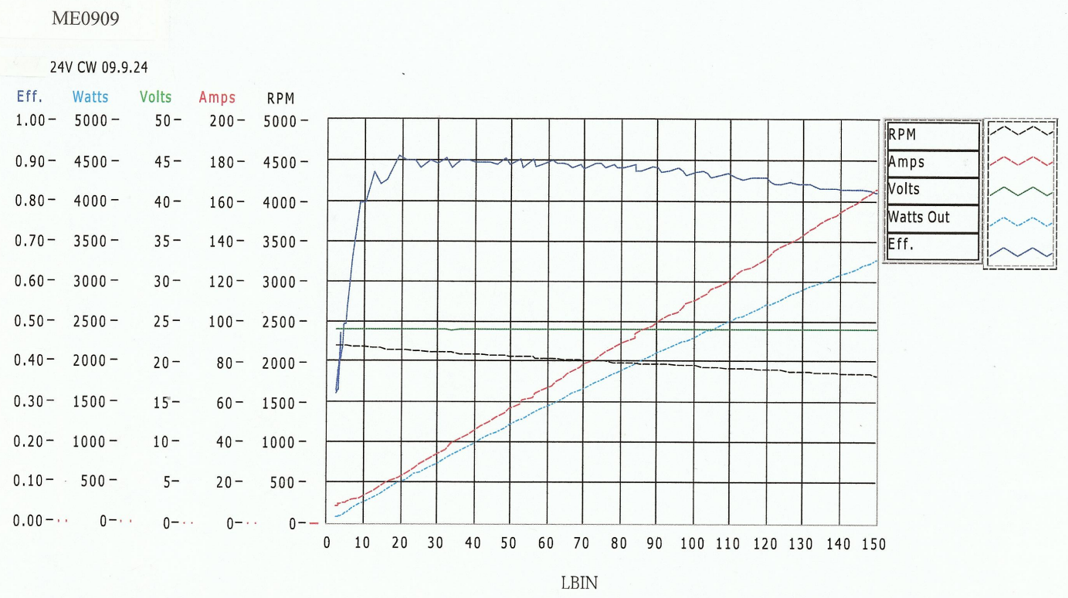
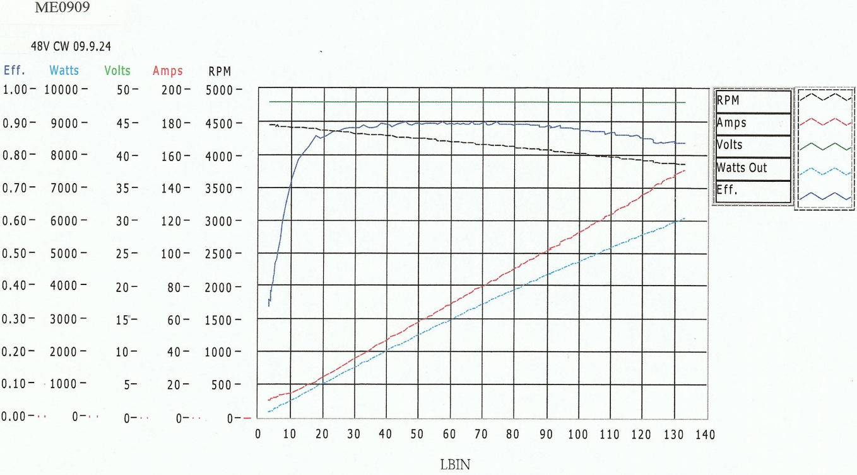
Motor Efficiency Data (ME0909)

Slide 34
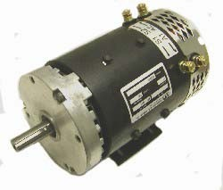
Brushed Motor Examples
Advanced DC K91-4003 motor, 48-96VDC
  Old motor – difficult to find
  Higher voltage motor (48-96 V)
  8 hp (cont.), 35 hp (peak)
  Strong motor for heavier cars
  Low cost ($800)

Slide 35
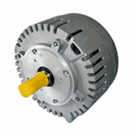
Brushless Motor Example
Motenergy ME1305/0907 Brushless PMAC/BLDC
  No brushes = no maintenance
  24-72 volts, 100 A (cont.) @ 48 VDC
  Very efficient (over 90%)
  High current (up to 100 amps continuous)
  Motor is inexpensive ($615)
  Special controller needed

Slide 36
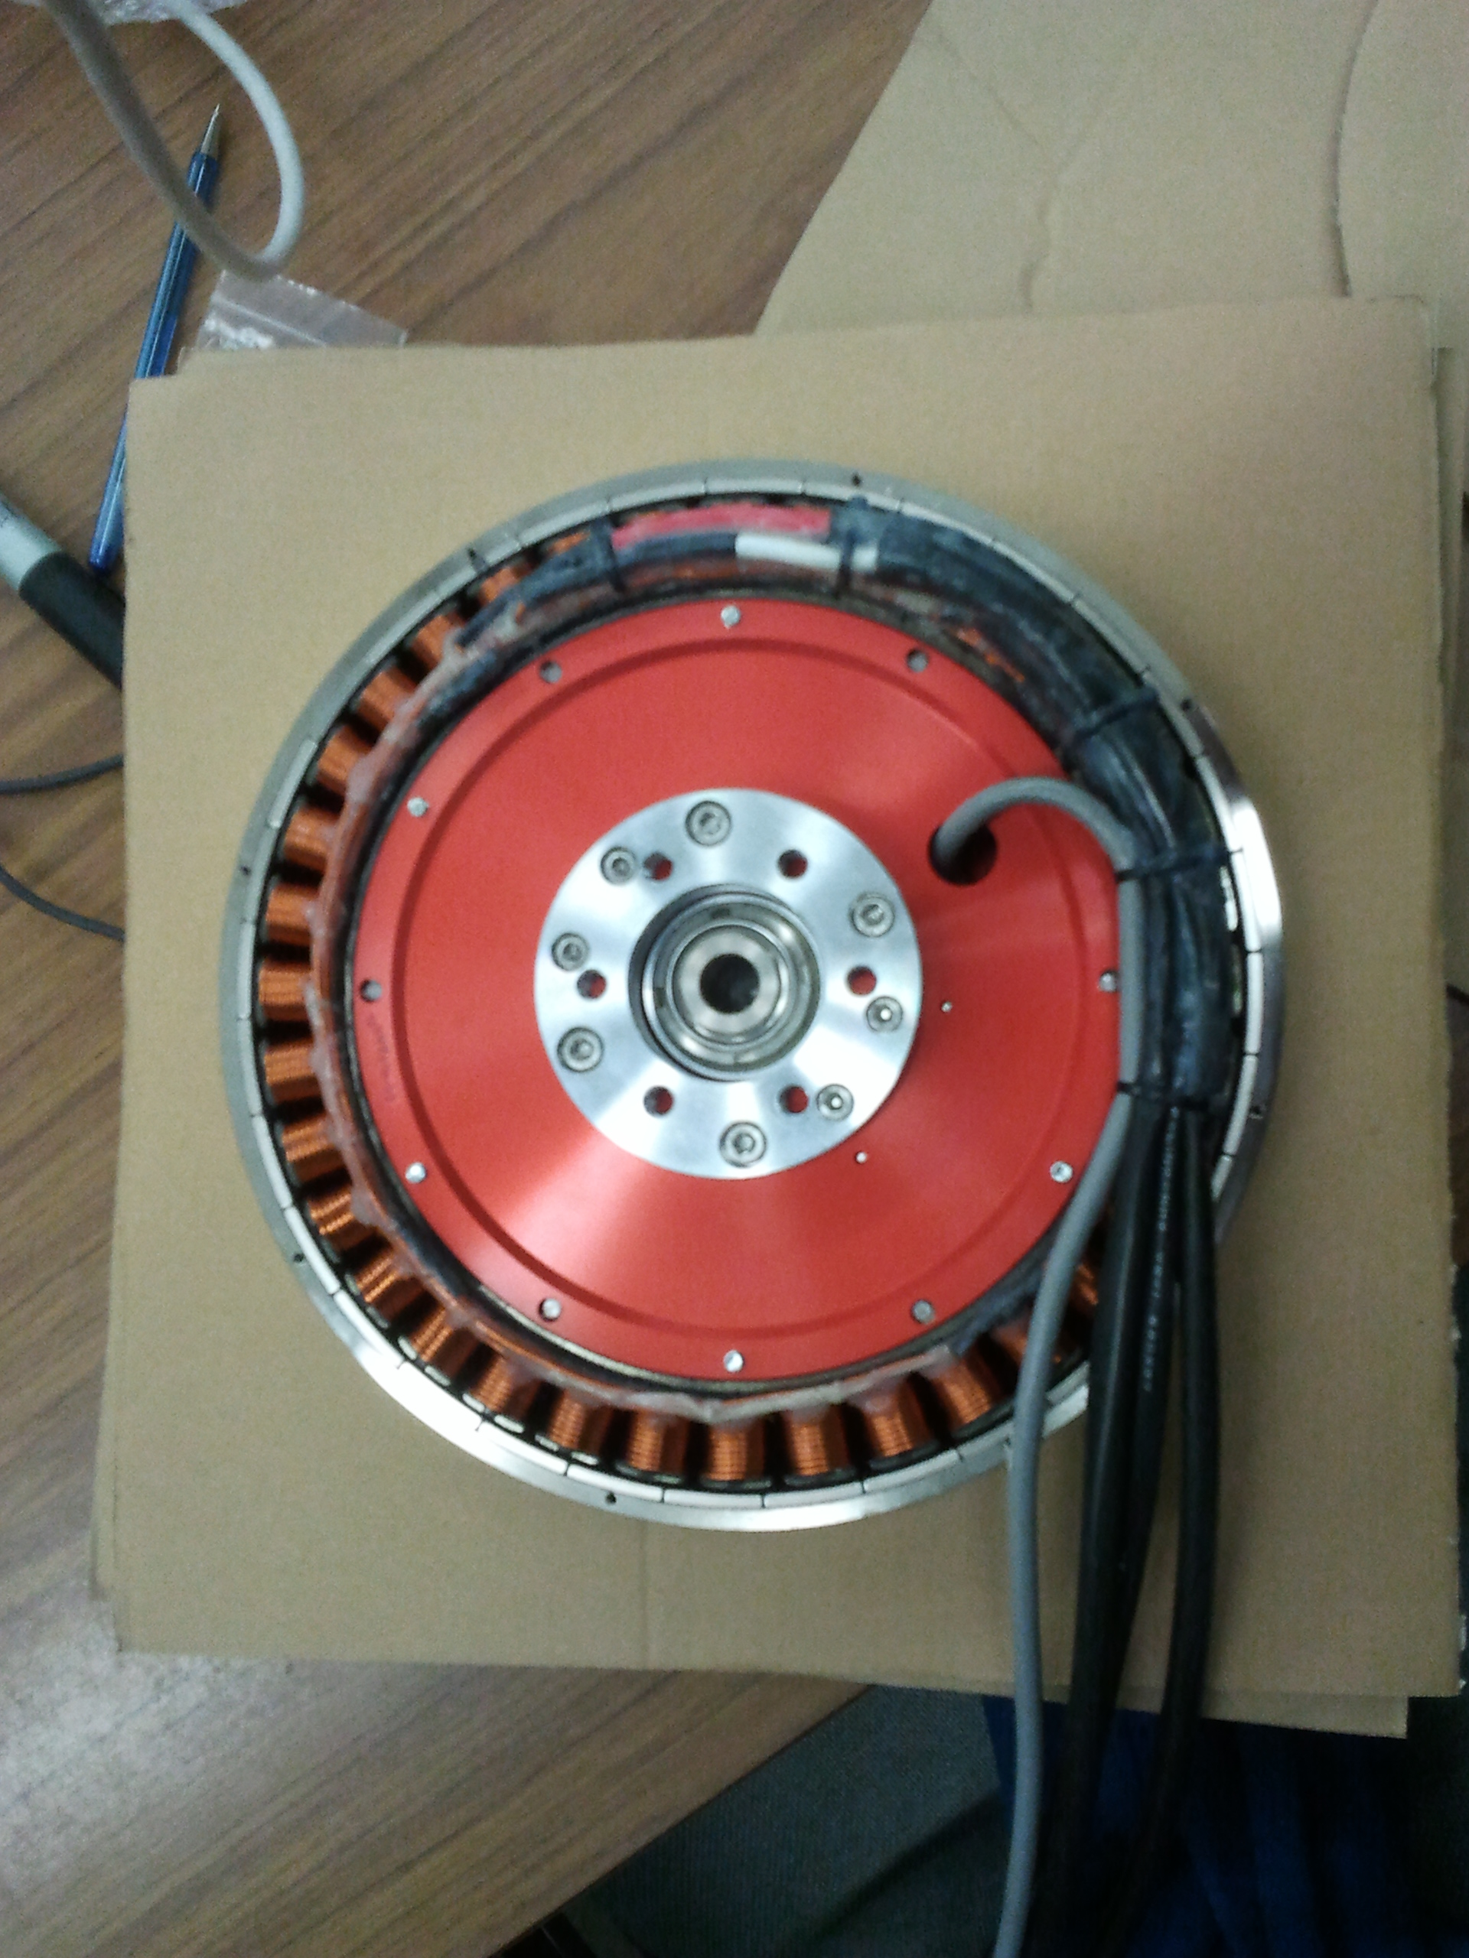
Hub Motor
NGM ‘Direct Drive’ high efficiency in-hub motor with variable air gap adjustment.
  Super efficient over a broad range of speeds
  No need for gears or chain
  Very expensive (Motor + controller > $25,000)
Mitsuba / Nomura hub motors replacing NGM as favored motor for solar car teams
  Still ~$25,000
Cheaper options have arrived…
  QS 205 (3-6 kW motor @72V) is popular; only $400; 85-92% efficient (claimed)

Slide 37
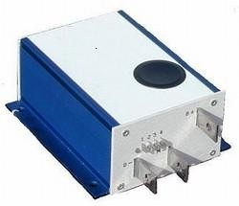
Brushed PWM Controller
Alltrax AXE
Easy to wire
0-5k Pot control
Programmable
Durable

Slide 38
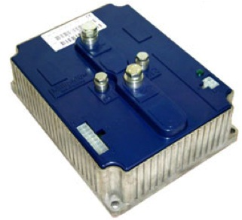
Brushless 3 Phase Controller
Sevcon
Battery +/- Input
3 phase output for brushless motors
Some have interlock system
(used for forklift driving safety)

Slide 39
Powering the solar car
Solar Arrays
Maximum Point Power Trackers (MPPT)
Batteries
Electric Motors
Gearing
The Electrical System
Everything Else Electrical

Slide 40

Choose the Correct Gears
Don’t gear a car for 50 mph if you are going to drive it at 25 mph. Be realistic about your cars speed!
Chain drive systems can be very efficient if gears are aligned and lubricated.
Pictured: 48V system, 15 tooth front, 70 tooth rear. Max speed = 36 mph

Slide 41


Gearing to match your motor
How fast will I go with…
$S_{MPH}== \frac{60∗M_{RPM}∗T_{SS}∗π∗D_{Wheel}}{T_{BS}∗5280∗12}$
Variable | Defined As
$$S_{MPH}$$ | Speed in Miles/Hour
$$M_{RPM}$$ | Target Motor RPM
$$T_{SS}$$ | # Teeth Small Sprocket
$$D_{Wheel}$$ | Diameter Wheel in Inches
$$T_{BS}$$ | # Teeth Big Sprocket

Slide 42

Choose the Correct Gears
Custom Sprockets:
Rocket Sprockets www.rocketsprocket.net
PMP Sprockets www.pmpsprocket.com

Slide 43
Powering the solar car
Solar Arrays
Maximum Point Power Trackers (MPPT)
Batteries
Electric Motors
Gearing
The Electrical System
Everything Else Electrical

Slide 44

Electrical System
Propulsion System
  Use the correct gauge wire for the job
  Disconnect switches should be designed for DC
  Fuses
Auxiliary electrical system (everything else on your car)
  Lights
  Fans
  Horn

Slide 45


Electrical Schematics

Slide 46
Powering the solar car
Solar Arrays
Maximum Point Power Trackers (MPPT)
Batteries
Electric Motors
Gearing
The Electrical System
Everything Else Electrical

Slide 47


Switches/Fuses
    There are a lot of resources for switches and fuses. Be sure they meet the race requirements before ordering!
    Be sure they are rated for your DC system. (AC rating will not qualify!)
    (Bussmann FWH Fuses are rated at 500V DC)
    Relays are required!
    Electric Motorsport www.electricmotorsport.com
    Tecknowledgey
    http://www.tecknowledgey.com
    No longer need “Big Red Button”
Single Pole On/Off
Rated load: 400 A
Break Current: 1200 A @ 48 V DC (600 A @ 96 V DC)
500V DC @90 amp fuse is about $50

Slide 48

Low Voltage Indicator
Cots Solution
Do-It-Yourself kit available at:
http://store.qkits.com/
Look for “Low Voltage Alarm”

Slide 49



Wire
Propulsion System Wire
  Use welding cable
    Should be very flexibly
  Use proper crimping tools and lugs
    Don’t attempt to solder
    Don’t attempt to splice
  Be aware of counterfeit cables
  Be sure to size to your system
Auxiliary System Wire
  Have a variety
  Get higher quality wire with more strands
http://www.flex-innovations.com/counterfeit.htm
Different Strand Configurations
For the same wire gauge

Slide 50






Heat Shrink
Heat shrink
  Should always be used
  It’s worth it to spring for the 3M heat shrink
  You will need a heat gun
X
✓

Slide 51



Soldering Tools
Wire strippers
  My preference is nothing fancy
Solder
  Lead free can be used but 60/40 Tin Lead Rosin Core is typical
  There are many diameters
    Very small diameter (0.6mm) solder is not meant for 16 ga / 18 ga wire
    Larger diameter (1.5mm+) solder is not appropriate for fine soldering (like making connections on a printed circuit board)
Irons vs Guns
  Irons
    Slow to heat up / slow to cool
    Precision temperature control and application with different tips
    Recommended for fine work (PCBs, solar Cells, ect.)
  Gun
    Fast to heat up / Fast to cool down
    One or two temperature settings
    Good for working on general solar car wiring
Most reliable wiring:
  Crimp connectors that have been crimped and soldered with a heat shrink sleeve
    Tin wires before putting them in the heat shrink

Slide 52
Powering the Solar Car
William Shih, Deputy Race Director

